Slide 1
Electron Configuration

Slide 2
Electron Configuration Revision

Slide 3
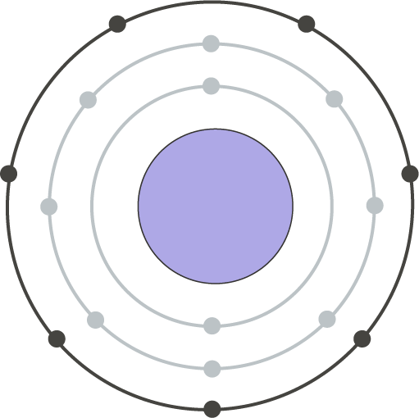
After you have completed this lesson, you should be able to:
State the order in which electrons fill electron shells and the number of electrons that can be found in each shell.
Draw electron shell diagrams for neutral atoms of the first 20 elements.
Write electron configurations for neutral atoms of the first 20 elements.
Explain what valence electrons are.
Identify the number of valence electrons in an atom using various methods.

Slide 4

Some elements are extremely reactive, like sodium and potassium. Others are extremely unreactive, like argon.
What determines the chemical reactivity of different elements? The answer lies in the arrangement of their electrons!

Slide 5
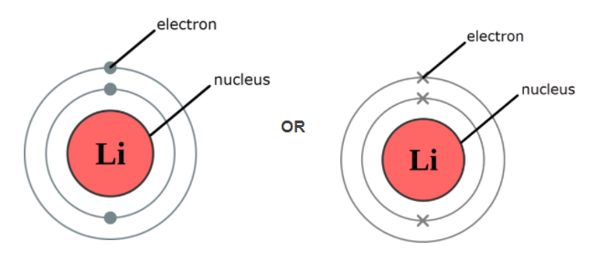
In an atom, electrons are constantly moving around the outside of the nucleus in electron shells or orbitals.
These shells are usually represented by circles in diagrams of atoms. Each shell is found at a different distance from the nucleus. Electrons are represented by either dots or crosses in these diagrams. The diagrams below show two different representations of a lithium atom which has two electrons in the first shell and one in the second shell.

Slide 6
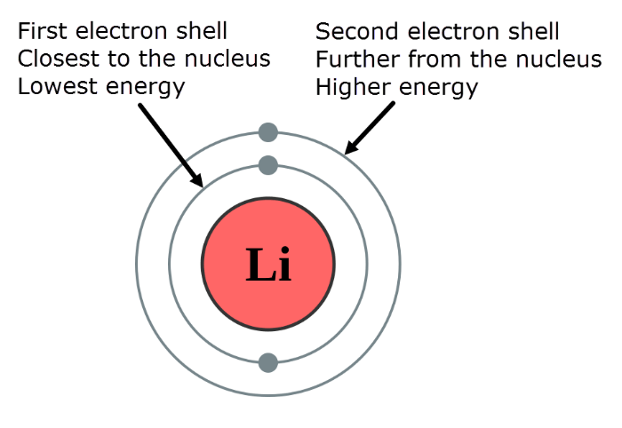
The closer the electron shells are to the nucleus, the lower their energy.
The first shell has the lowest energy, the second shell has the second lowest energy (higher energy than the first), and so on.

Slide 7

Electrons fill the electron shells starting from the shell closest to the nucleus (lowest energy level).
Each shell can only hold a certain number of electrons. Like a full teacup, a full electron shell cannot accept any more electrons, and so the electrons are added to the next shell, and so on.

Slide 8
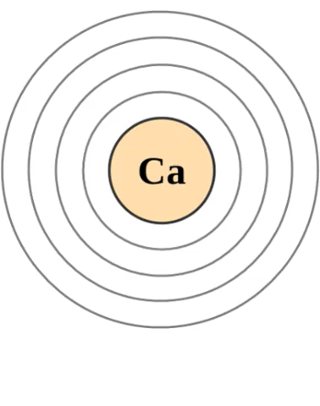
How many electrons can each shell hold?
The first electron shell (the one closest to the nucleus) can hold up to 2 electrons.
The second electron shell can hold up to 8 electrons.
The third electron shell can hold up to 8 electrons.
After all these shells are full, the electrons begin to fill the fourth electron shell. For example, the electrons in a calcium atom are arranged as shown below:

Slide 9
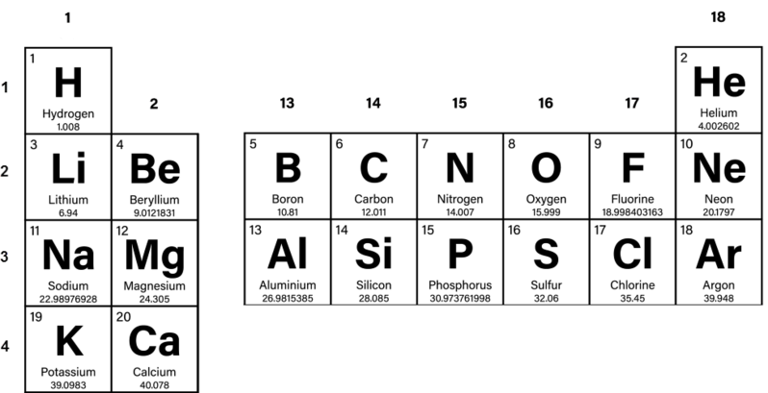
By using the periodic table, you can work out how many electrons are in an atom and therefore draw the arrangement of these electrons.
For example, could you draw the electron arrangement for a boron atom by using the information below?

Slide 10
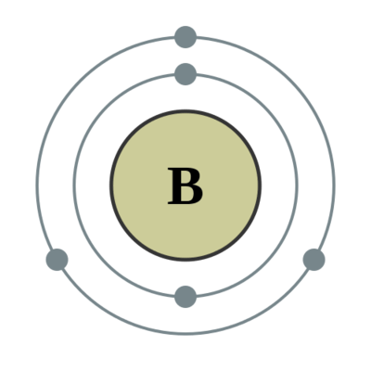
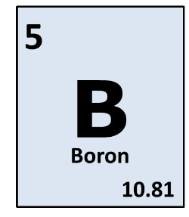
Boron has an atomic number of 5. This means there are 5 electrons in a neutral atom of boron.
The first electron shell can hold up to 2 electrons, while the second can hold up to 8 electrons. This means you would draw two electrons in the first shell, and the remaining three in the second shell.

Slide 11

The electron configuration of an atom refers to the arrangement of electrons in its shells.
Drawing out diagrams to show which shells the electrons are found in for each atom can be quite cumbersome. This is why scientists use a much simpler, shorthand method.

Slide 12
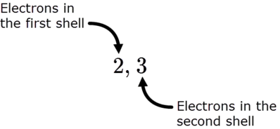
We can write the shorthand electron configuration by using numbers separated by commas. The numbers indicate the number of electrons in each shell. The commas indicate where the different shells start.
For example, a boron atom has two electrons in the first shell and three in the second shell. We write the electron configuration as 2,3.

Slide 13
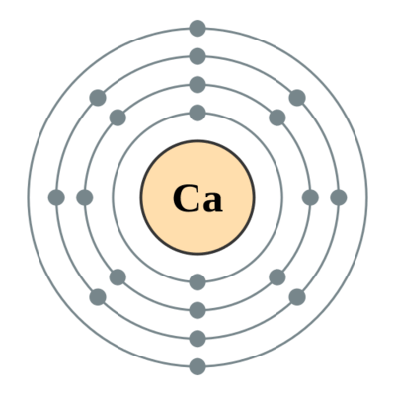
As you can imagine, this saves a lot of time when you want to indicate the number of electrons in an atom such as calcium!
Calcium has 20 electrons, so we can write its electron configuration as 2,8,8,2.

Slide 14
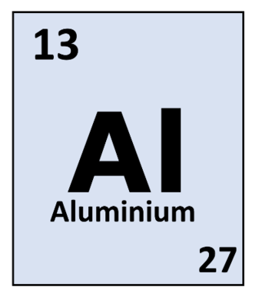
You can also work backwards from a given electron configuration to determine what the element is. For example, what is the element with the electron configuration of 2,8,3 for its neutral atom?
The total number of electrons in a neutral atom is equal to the atomic number of that element, so you can simply add up the number of electrons and then find that element on the periodic table. In this case, there are 13 electrons. The element with an atomic number of 13 is aluminium.

Slide 15
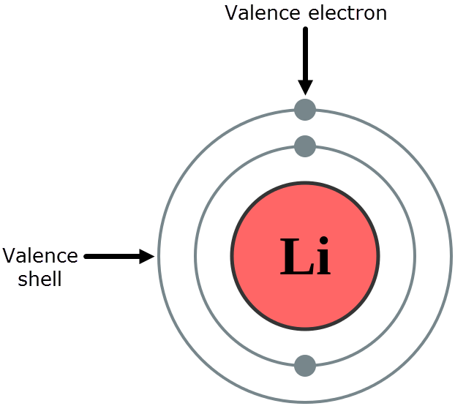
Remember how the chemical reactivity of an element depends on the arrangement of its electrons? It actually depends only on the number of electrons in the outermost electron shell.
The electrons in the outermost shell are called valence electrons and this shell is called the valence shell.

Slide 16
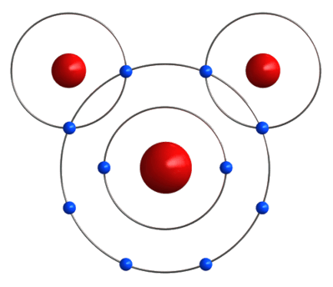
The valence electrons are the electrons that are involved in bonding and chemical reactions of atoms.
An atom is most stable when its valence shell is full of electrons, or empty of electrons. During chemical reactions, atoms will gain, lose or share electrons with other atoms in order to achieve a more stable state.
Atoms with the same number of valence electrons tend to react in the same way. You'll learn more about this in the next Smart Lesson. For now, let's focus on identifying the number of valence electrons that are present in an atom.

Slide 17
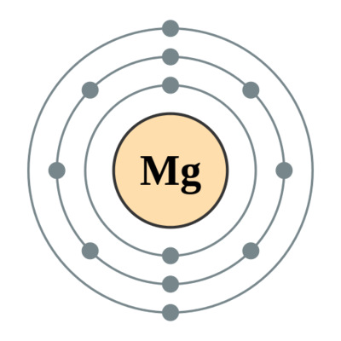
The number of valence electrons in an atom can be identified in several ways.
1. Count the number of electrons in the outer shell of a diagram or picture.
For example, the outer shell of the atom in the diagram below has two electrons in it. This atom has 2 valence electrons.

Slide 18
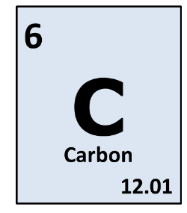
2. Take only the last number of an electron configuration.
For example, the electron configuration of a carbon atom is: C=2,4. Carbon atoms have 4 valence electrons.

Slide 19
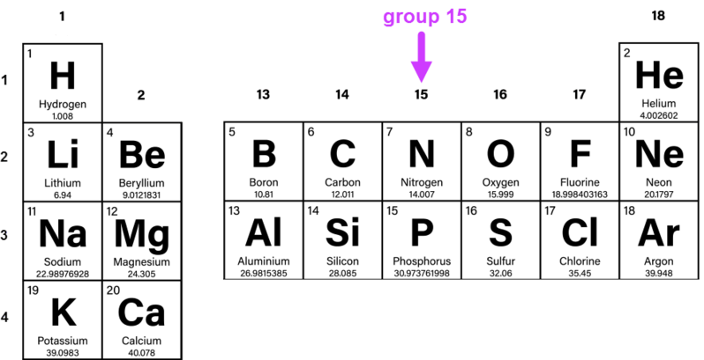
3. Identify which group of the periodic table the atom is in.
For elements in groups 1 and 2, the number of valence electrons is equal to the group number (i.e. 1 or 2 valence electrons respectively). For elements in groups 13−18, the number of valence electrons is equal to the group number minus 10 (i.e. 3-8 valence electrons respectively).
For example, nitrogen is in group 15, therefore a neutral atom of nitrogen has 5 valence electrons.

Slide 20
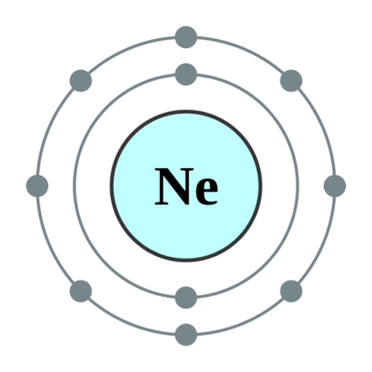
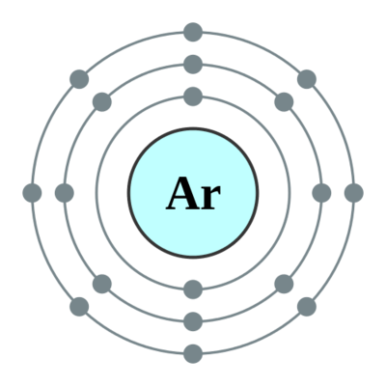
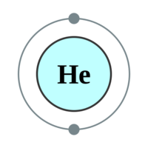
Elements in group 18 have full valence electron shells. This means they do not need to gain or lose any electrons to become stable, so they don't take part in any chemical reactions.
Helium has 2 valence electrons as its valence shell is the one closest to the nucleus. Neon and argon each have 8 valence electrons.

Slide 21
Electron Configuration of atoms

Slide 22

You have already learned that atoms can be modelled as a nucleus surrounded by electrons in distinct energy levels, held together by electrostatic forces of attraction between the nucleus and electrons. The locations of electrons within atoms can be represented using electron configurations.
However, this is a simplified model to understand some atomic properties.
In this Smart Lesson you will look in more detail at electron configuration, and will be introduced to the s, p and d orbitals in energy levels.

Slide 23
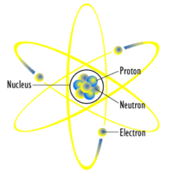
In previous years of learning chemistry, you have probably been taught that an atom consists of a nucleus containing protons and neutrons, with electrons orbiting the nucleus, perhaps similar to this diagram:
You now need to know that this idea is slightly wrong. Electrons are found in regions of space called orbitals, but this does not mean that they "orbit" the nucleus.
An atomic orbital is an energy level with a certain shape and size, in which an electron is highly likely to be found at any point in time. Energy level diagrams are used to describe the energy of atomic orbitals and the location of the electrons.

Slide 24
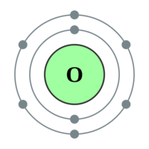
The electron shells that you may be used to talking about are depicted in this diagram of an oxygen atom. Oxygen has two electron shells, with the first containing two electrons and the second containing six electrons.
The innermost electron shells have the lowest energy, and the energy increases as shells get further away from the nucleus. Remember:
- | The first electron shell can contain only two electrons.
- | The second electron shell can contain up to 8 electrons.
- | The third electron shell can contain up to 18 electrons.
Within each electron shell, there are subshells, which are groups of atomic orbitals. There are four different types of subshell, known as the s,p,d, and f subshells. Each subshell has a different number of atomic orbitals that make it up, and the atomic orbitals in each subshell have characteristic shapes.

Slide 25
The s,p and d orbitals have the shapes shown in the diagram below.
What you do need to know is that each atomic orbital can hold two electrons. There is always one s orbital, three p orbitals, five d orbitals, and seven f orbitals, but not every energy level (shell) contains every type of orbital, as shown in the diagram below.

Slide 26
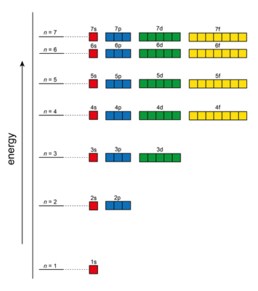
The first energy level (shell) contains only one s orbital, and therefore can contain only two electrons. The second energy level contains one s orbital and three p orbitals, and can therefore contain up to 8 electrons. The third energy level contains one s orbital, three p orbitals, and five d orbitals, and can therefore contain up to 18 electrons.

Slide 27
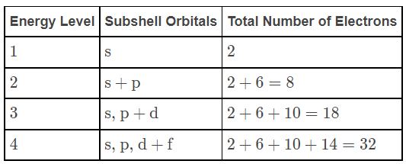
Below is a table that illustrates which orbitals will be found in each energy level and the maximum amount of electrons that can be placed in each energy level.

Slide 28
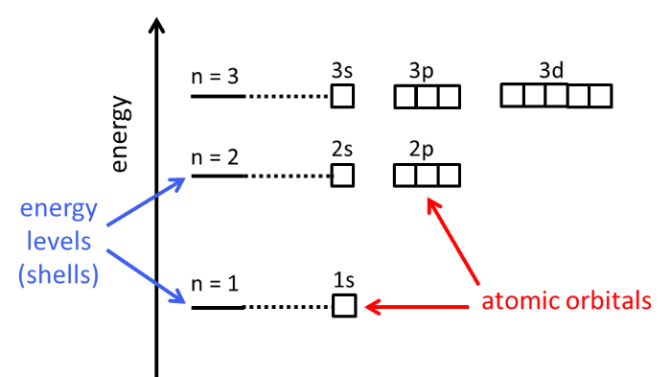
In an energy level diagram, like the one shown below, energy increases up the y axis. Atomic orbitals are depicted by small boxes, and each box can only contain two electrons. Electrons are depicted by arrows, with one pointing up and one pointing down in each orbital (box).
The orbitals are labelled to indicate both the energy level and the subshell or atomic orbital level. For example, the s orbital in the first energy level is called the 1s orbital. The p orbitals in the second energy levels are called the 2p orbitals. Electrons always fill orbitals starting from the lowest energy orbital (1s).

Slide 29
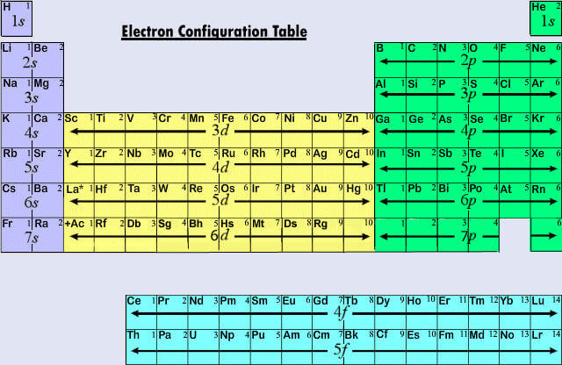
The Periodic table is based on the electronic configuration of atoms, and is arranged into 4 blocks associated with the 4 sub-levels: s, p, d and f.

Slide 30
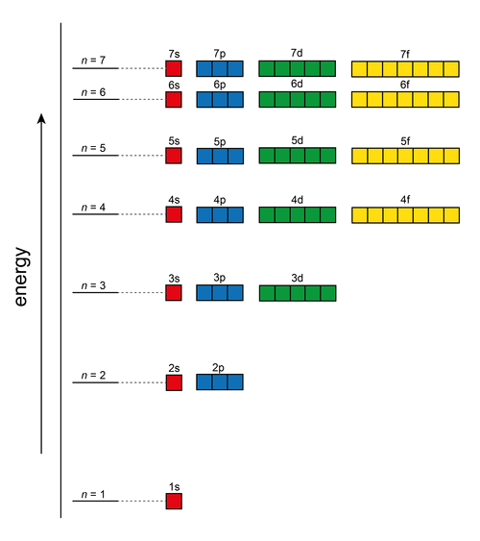
You have just learnt about atomic orbitals and how many electrons each orbital and set of orbitals can hold. So how can we use this information to predict the electron configurations of atoms?
To predict electron configurations for atoms in their ground state, we use the Aufbau Principle. The Aufbau Principle states that lower energy orbitals will fill before higher energy orbitals.

Slide 31
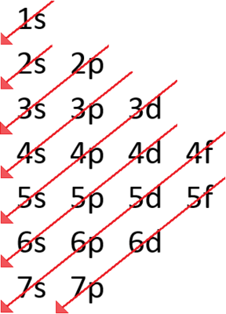
The Madelung Rule tells us the order in which orbitals will be filled, and it is summarised in this diagram: It is read by starting at the top with the 1s orbital, and then following the arrows down.
You will only be asked to write electron configurations for atoms containing electrons in up to the 4p shell. An important thing to remember is that the 4s orbitals fill with electrons before the 3d orbitals. This is because 4s orbitals have a slightly lower energy due to their shape.

Slide 32
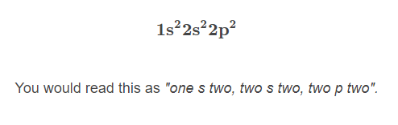
When writing out electron configurations, we write out all of the orbitals that contain electrons in a sequence, and indicate the number of electrons in each set of orbitals using a superscript number. Remember that different sets of orbitals can contain different numbers of electrons: s orbitals can hold 2 electrons, the p orbitals can hold 6 electrons and the d orbitals can hold 10 electrons.
For example, the electron configuration of carbon is written as:

Slide 33
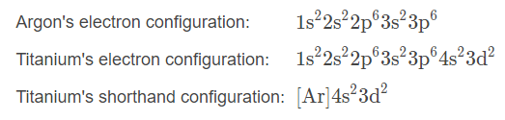
Valence electrons are the only electrons that are involved in chemical reactions, so the electrons in the inner shells are relatively unimportant. This means we can use a shorthand way of writing the electron configuration for larger atoms.
The noble gases (He, Ne, Ar, Kr) all have full valence shells, so we can use them as the "core" for larger atoms and then simply add the electrons in the outer shells to the end of the configuration. For example:

Slide 34
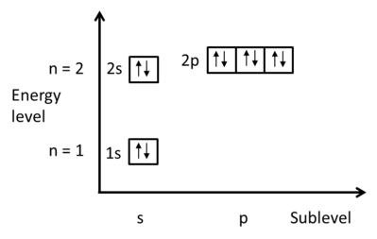
Energy level diagrams can be used to show the electron configuration of atoms. They are a good way to visualise how electrons fill from the lowest energy orbitals to the higher energy orbitals. Electrons are drawn as arrows pointing up or down. Each small box represents one atomic orbital, and therefore can contain two electrons. For example, here is the electron configuration diagram for neon:
Notice that each box contains one electron pointing up and one pointing down. This is because of some complicated quantum mechanics and a property of electrons called spin, which means that electrons in the same orbital must have opposite spins. This is known as the Pauli exclusion principle. All you need to remember is to always draw one electron pointing up and one pointing down when there are two electrons in the same orbital.

Slide 35
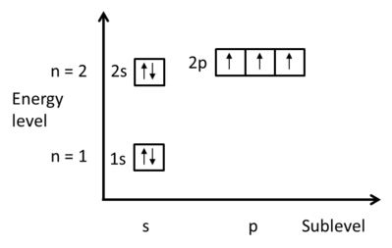
Nitrogen has 7 electrons. Here is the electron configuration diagram for nitrogen:
Notice that in the 2p orbitals, each electron is in a separate atomic orbital. This is because of Hund's Rule, which states that each electron is placed into an empty orbital before pairing up. Note that this is only for atomic orbitals in the same sublevel, i.e. electrons will still pair up in the 2s orbitals before filling the 2p orbitals. Hund's Rule arises from the consideration of energy: it requires more energy for electrons to pair up in the same atomic orbital than to be in separate orbitals. This is because electrons are negatively charged, and like charges repel!

Slide 36

There are some atoms which are exceptions to the Aufbau Principle, in which a lower energy atomic orbital is not completely filled before a higher energy atomic orbital is filled. The two exceptions to the rule are chromium and copper. Experimentally, they have the electron configurations shown below:
Both of these atoms have an electron placed in the 3d orbital (higher energy) before the 4s orbital (lower energy). This is because both full and half-full sets of orbitals result in a lower overall energy of the atom (i.e. a more stable atom). Remember Hund's Rule: electrons have lower energy when they are unpaired.

Slide 37
Electron Configuration of Ions

Slide 38

In this Smart Lesson you will learn how to determine the electronic configuration of ions.

Slide 39
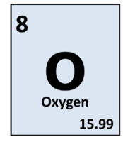
You have already looked at how to determine the electron configuration of an atom, for example if you look at oxygen on the periodic table, you will see that it has an atomic number of 8.
This means it has {8}8 protons, and in the uncharged atom, it will have 8 electrons, in the electron configuration 2,6
This is because the first shell only holds 2 electrons. The remaining electrons are in the second shell.

Slide 40
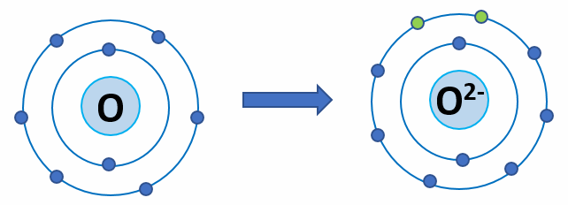
When an atom becomes an ion, it loses or gains electrons to attain a full outer shell. As oxygen is a non-metal, it will gain 2 electrons to have a full outer shell. This means the electron configuration of the oxygen ion is 2,8

Slide 41
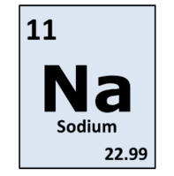
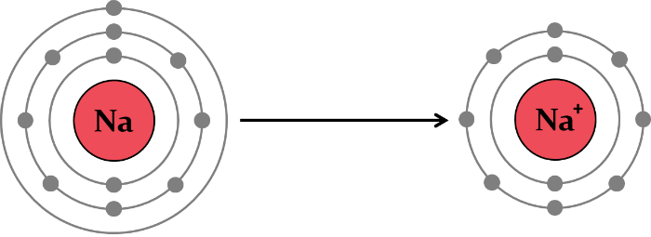
Another example would be the formation of a sodium ion. If you look at the periodic table, you will see sodium has an atomic number of 11, which means the atom has 11 electrons, arranged 2,8,1.
To become an ion, sodium is a metal, so loses its outer electron, forming an electron configuration of 2,8. Notice how the electrons in ions are noble gas configurations.

Slide 42
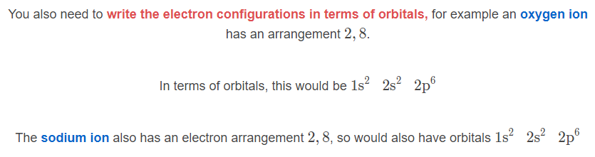

Slide 43
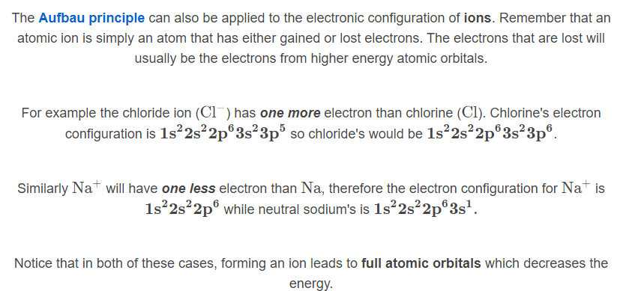

Slide 44
